Slide 1
Project Title :
Smart Waste Management System Using AI and Computer Vision
Team Name: Code Spark
Team Member : Tanmay Warkhede (Team Leader)

Slide 2
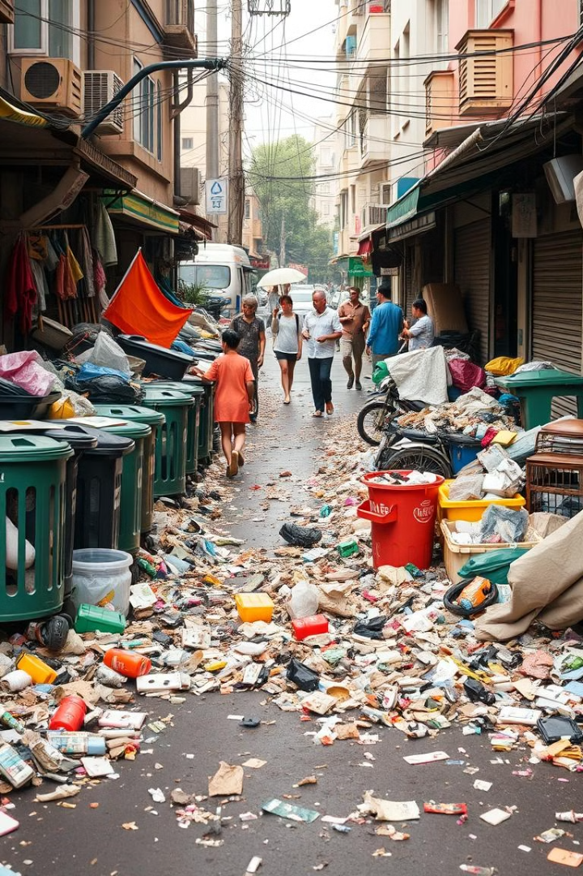
Problem Statement
1
Waste Mismanagement
2
Operational Inefficiencies
Improper sorting and recycling practices lead to contaminated recyclables, hindering resource recovery.
Traditional waste collection methods are costly and inefficient, resulting in wasted time and resources.
3
Lack of Community Engagement
Limited awareness and participation in sustainable waste disposal practices hinder environmental progress.

Slide 3
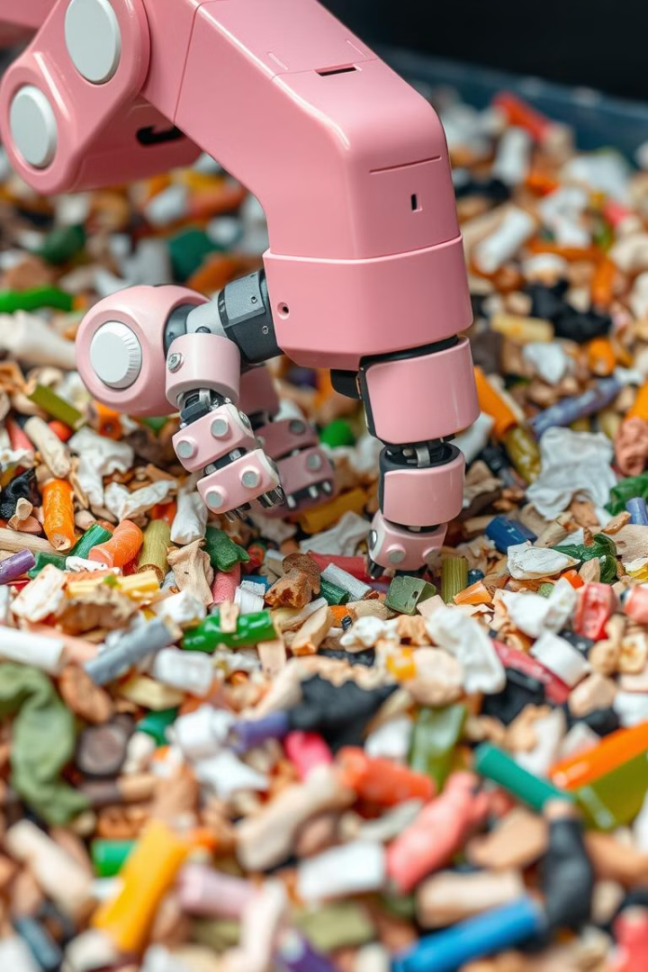
Smart Waste Management System
AI-Based Waste Classification
Types of Waste Detected
Our system identifies a range of waste materials, including plastic, textiles, wood, and other recyclable and non-recyclable materials.
Utilizing advanced machine learning algorithms, our system accurately identifies waste categories in real-time, minimizing contamination.
Automated Sorting
Reduces human error and contamination in the recycling process, maximizing resource recovery and minimizing waste.

Slide 4




Technical Implementation
Machine Learning Model
Our system utilizes a trained machine learning model to accurately identify waste categories based on image data.
Real-Time Camera Integration
The system employs cameras to capture images of waste, allowing for real-time classification and sorting.
Mobile App
The mobile app provides users with waste management information, collection schedules, and notifications, promoting user engagement and awareness.

Slide 5
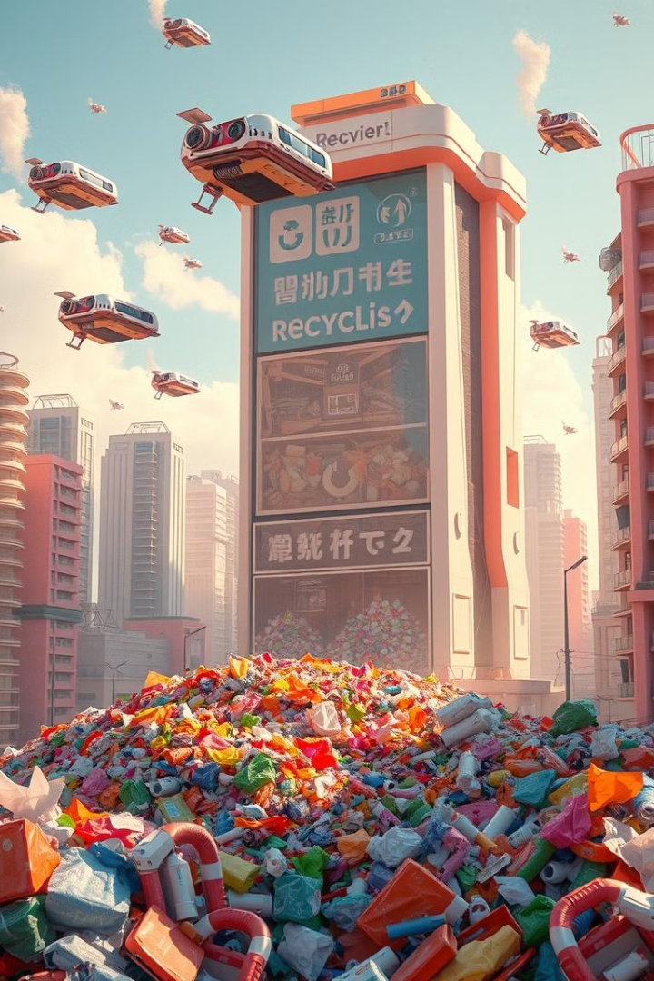
Future Outlook
1
Current Status
We have developed a functional prototype of our smart waste management system, including a working AI classification engine and mobile app integration.
2
Future Expansion
We plan to expand our system to include a wider range of waste categories, integrating it into larger smart city initiatives for comprehensive waste management.
3
Scaling the Solution
We aim to partner with municipalities to deploy our system on a larger scale, improving machine learning model accuracy and expanding waste type identification capabilities.

Slide 6
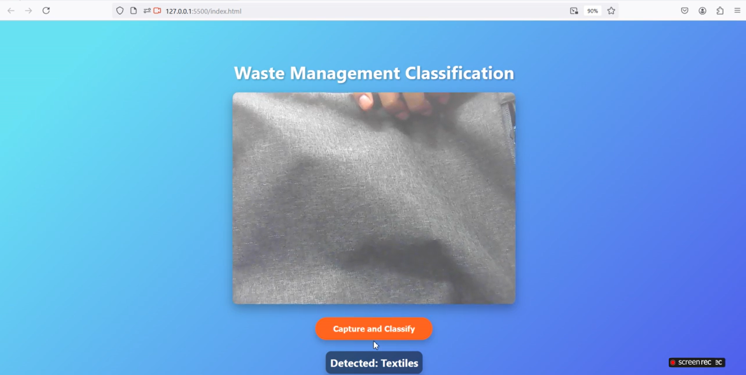
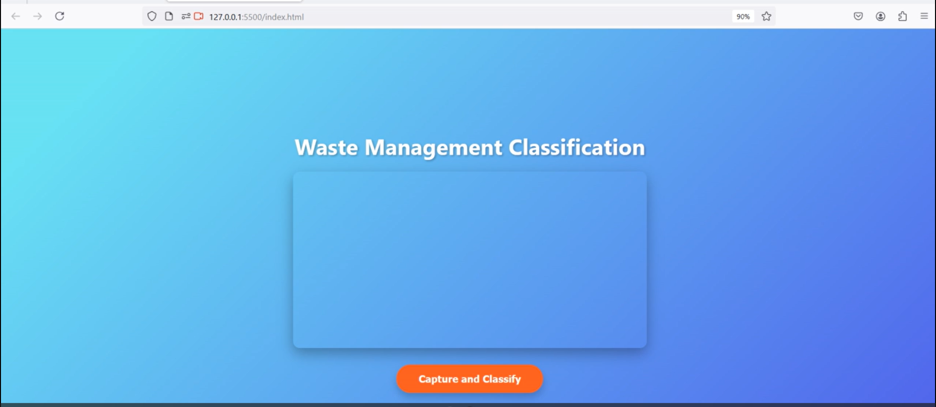
Screenshots:
Link of Video :
https://drive.google.com/file/d/1XaBg5YnuiKwk5Spqt06klBstJCk7nmdr/view?usp=sharing
Code :
https://github.com/TanmayWarkhede/SWM.git

